Slide 1
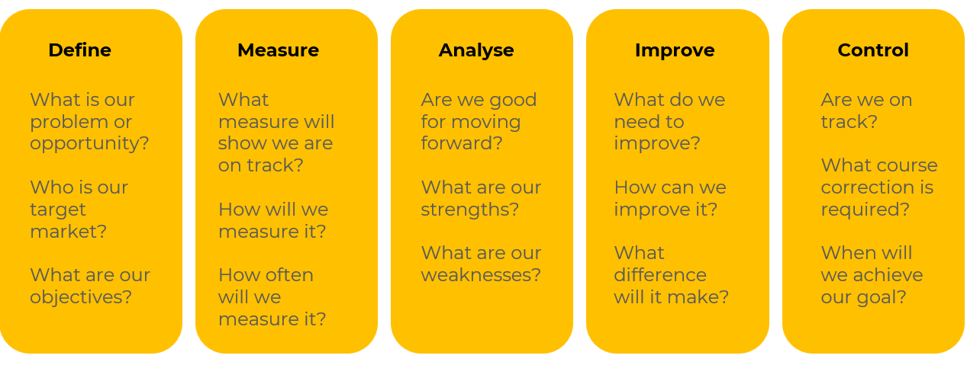
DMAIC

Slide 2
A business model for finding a competitive advantage.
Use this framework to achieve quality strategic plans
DMAIC (Define, Measure, Analyse, Improve, Control) is a problem-solving methodology commonly associated with Six Sigma, a set of techniques and tools for process improvement. While DMAIC is traditionally used for improving and optimising existing processes, it can also be adapted to support strategic planning initiatives.
Applying DMAIC to strategic planning provides a structured and data-driven approach to identify, address, and monitor strategic issues. It helps companies make informed decisions, align resources effectively, and adapt to changes in the business environment. Keep in mind that while DMAIC is a powerful tool, it may need to be customized to suit the unique aspects of strategic planning in different organizations.

Slide 3
Define.
Clearly define the strategic objectives you aim to achieve. This involves understanding the organisation's mission, vision, and long-term goals. Define the scope of your strategic planning efforts, including the areas of focus and the stakeholders involved.
 | Complete these boxes
What are your company’s goals in the short, medium and long term?
What are you focussed on in your strategic plan that requires a quality assessment?

Slide 4
Measure.
Gather relevant data related to the strategic objectives. This may include market trends, customer feedback, financial metrics, and other key performance indicators (KPIs). Measure your company’s current performance against industry benchmarks and competitors to identify performance gaps.
 | Complete these boxes
What are the trends in your market? What is the trend in your revenues and profit within the market?
What are your production levels? What is our productivity per employee? How does this compare with competitors?
What are your levels of customer satisfaction and Net Promoter Scores?

Slide 5
Analyse.
Conduct a SWOT analysis (Strengths, Weaknesses, Opportunities, Threats) to assess internal and external factors affecting the company’s strategic position. Identify the root causes of any performance gaps or challenges hindering the achievement of strategic objectives.
 | Complete these boxes
What does the SWOT tell you as actions? What can you do to exploit your strengths and opportunities? What weaknesses need correcting?
What is causing problems in the company ie the root cause of weaknesses? Why are you beating the competition in certain areas?
Where are things getting better or worse for your company in its market?

Slide 6
Improve.
Develop and implement strategic initiatives based on the analysis. This could involve changes to processes, resource allocation, technology adoption, or organisational structure. Introduce innovative solutions or practices to enhance your company’s competitiveness and align with strategic goals.
 | Complete these boxes
What actions are required to head off any threats or exploit any opportunities?
What resources are required to make these changes?
What is the plan for improvements? Who will do what, by when and with what resources?

Slide 7
Controls.
Establish metrics and key performance indicators to monitor the progress of strategic initiatives. Implement control mechanisms to ensure that the organisation continues to adapt and improve in response to changing circumstances.
 | Complete these boxes
How will you control the steps you are taking to make improvements? What KPIs will you use? Who will check and control them?
At what stage will you decide to make a course correction rather than hang on to see if things level out?

Slide 8
Editable framework.
Use this to add your own text and edit to suit your own branding
DEFINE
MEASURE
ANALYSE
IMPROVE
CONTROL

Slide 9
Thank you.

